Slide 1








Delicious Pizza for Everyone!
PIZZA SALES
SQL PROJECT
@Kartikeya_Maurya

Slide 2

Hello!
Hello, my name is Kartikeya Maurya. In this project, I leveraged SQL queries to perform comprehensive data analysis. The project, titled Pizza Sales Data Analysis, showcases my ability to extract valuable insights and trends from complex datasets.
@Kartikeya_Maurya

Slide 3
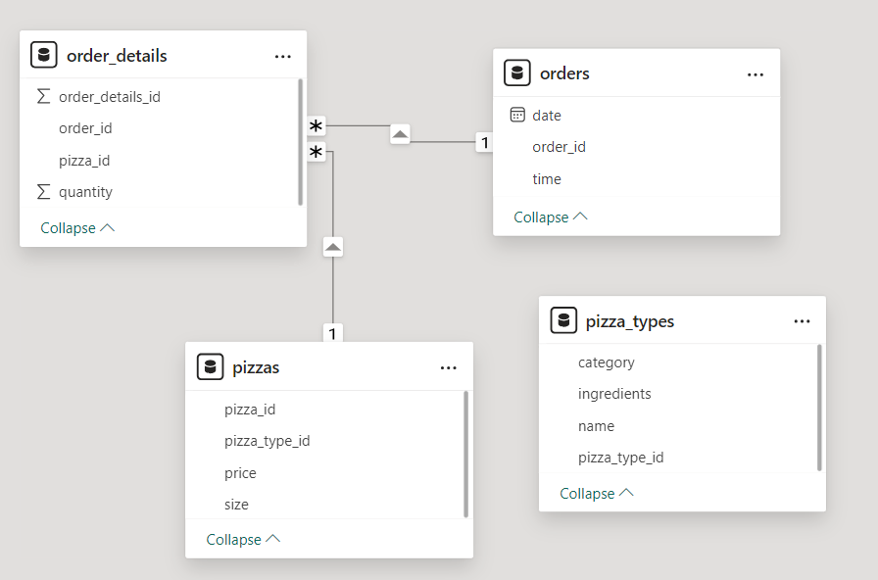
Model View
@Kartikeya_Maurya

Slide 4
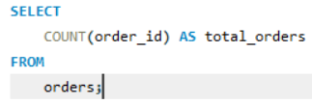



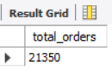
Retrieve the total number of orders placed.
@Kartikeya_Maurya

Slide 5
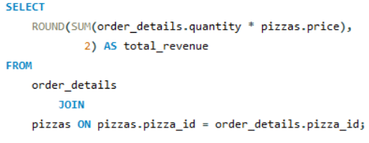

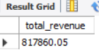
Calculate the total revenue generated from pizza sales.
@Kartikeya_Maurya

Slide 6
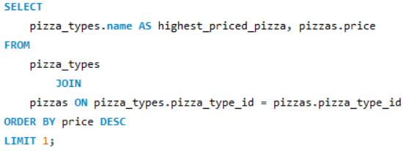

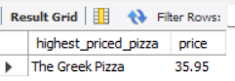
Identify the highest-priced pizza.
@Kartikeya_Maurya

Slide 7
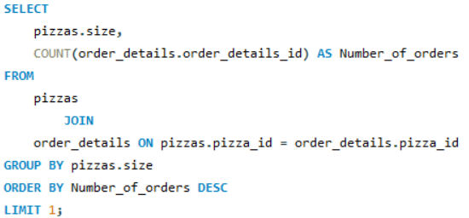

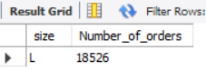
Identify the most common pizza size ordered.
@Kartikeya_Maurya

Slide 8
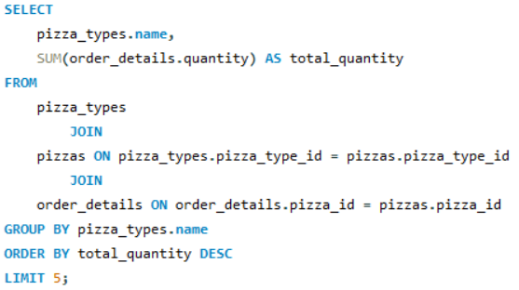

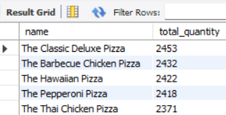
List the top 5 most ordered pizza types along with their quantities.
@Kartikeya_Maurya

Slide 9
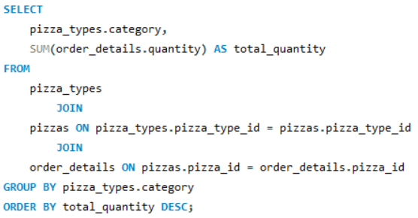

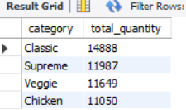
Join the necessary tables to find the total quantity of each pizza category ordered.
@Kartikeya_Maurya

Slide 10
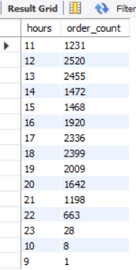
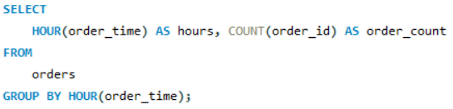

Determine the distribution of orders by hour of the day.
@Kartikeya_Maurya

Slide 11
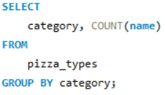
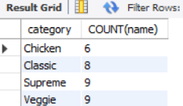

Find the category-wise distribution of pizzas.
@Kartikeya_Maurya

Slide 12
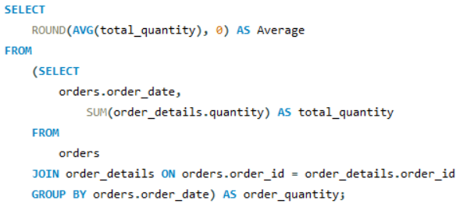
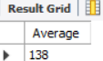

Group the orders by date and calculate the average number of pizzas ordered per day.
@Kartikeya_Maurya

Slide 13
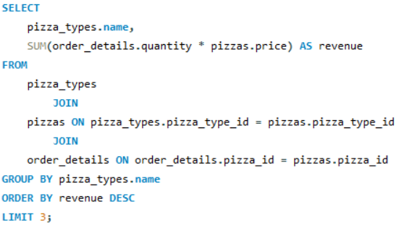
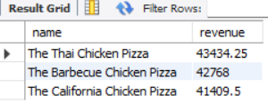
Determine the top 3 most ordered pizza types based on revenue.
@Kartikeya_Maurya

Slide 14
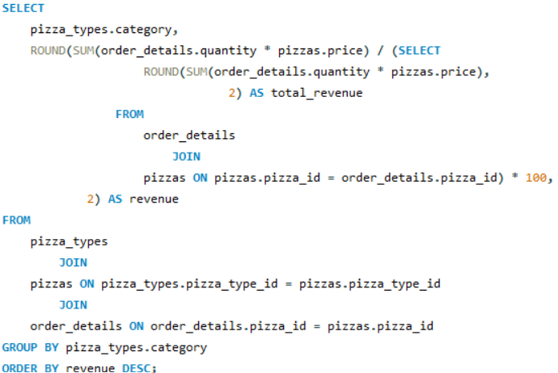
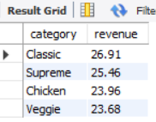
Calculate the percentage contribution of each pizza type to total revenue.
@Kartikeya_Maurya

Slide 15
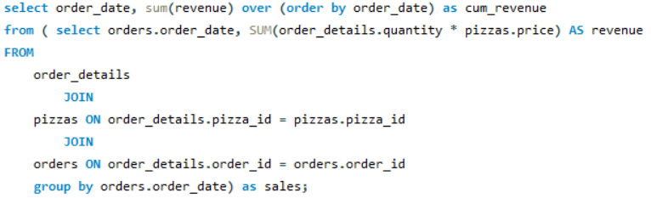
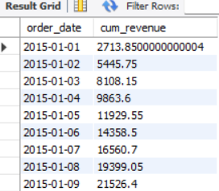

Analyze the cumulative revenue generated over time.
@Kartikeya_Maurya

Slide 16
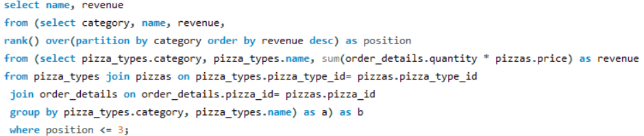
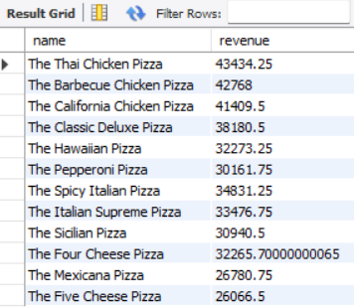
Determine the top 3 most ordered pizza types based on revenue for each pizza category
@Kartikeya_Maurya

Slide 17
THANK
YOU
@Kartikeya_Maurya

